Slide 1
PBSES at Newcastle
Presentation for PTSA

Slide 2
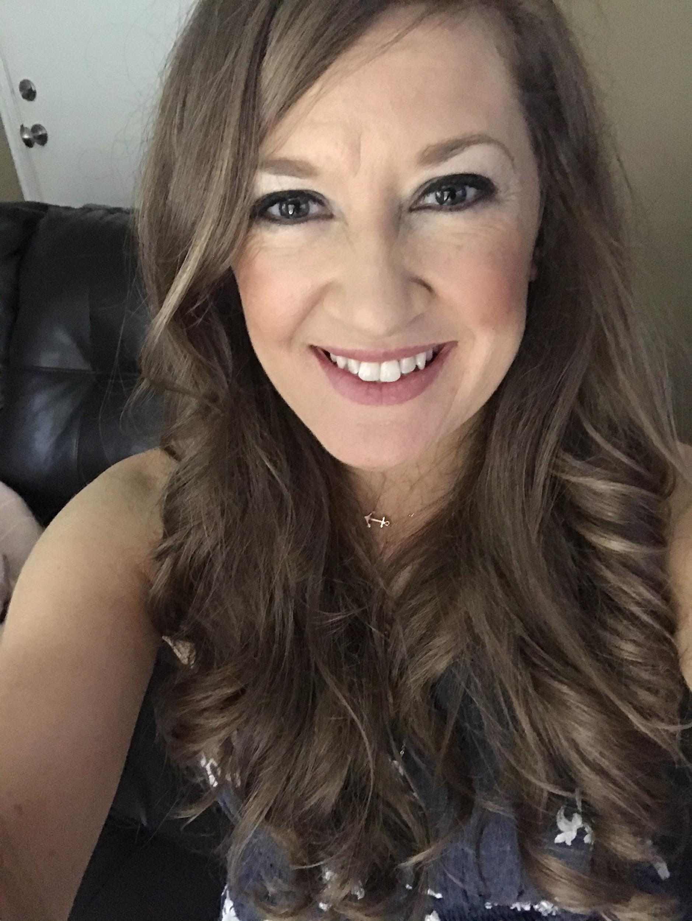
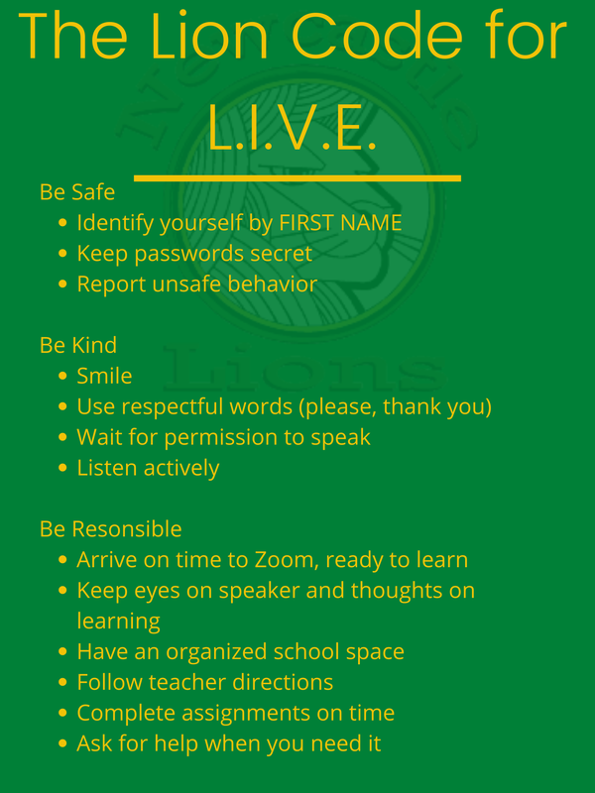
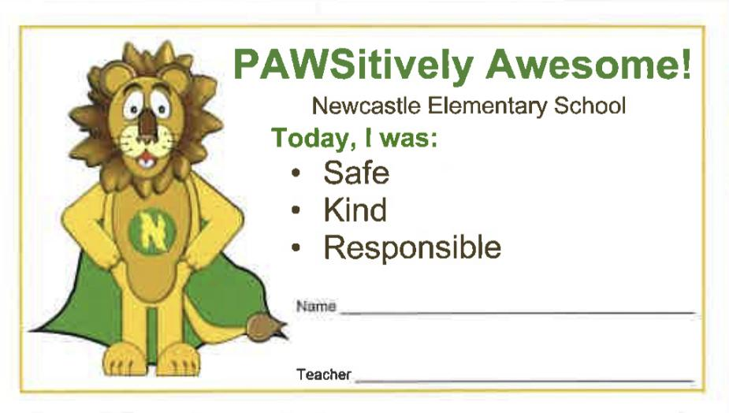
Mrs. Norton-PBSES Coach
P-Positive
B-Behavior
S-Social
E-Emotional
S-Support

Slide 3
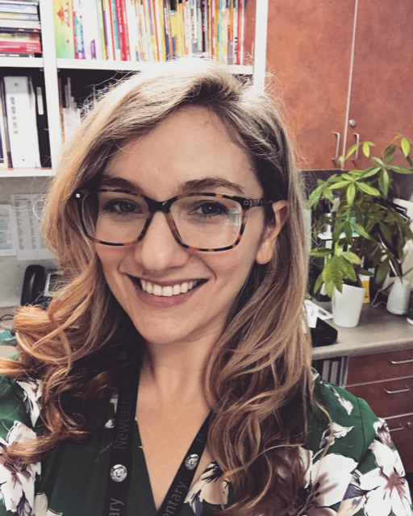
Meet Your...
School Counselor - Ms. Mutter!
How I Can Help:
-Missing someone?
-Friendship?
-Family?
-Big Feelings?
-School-work?
-Chat?

Slide 4
Your Teachers are...
prioritizing positive relationships
integrating social emotional activities
teaching 2nd Step lessons
leveraging academic curriculum to promote wellness

Slide 5
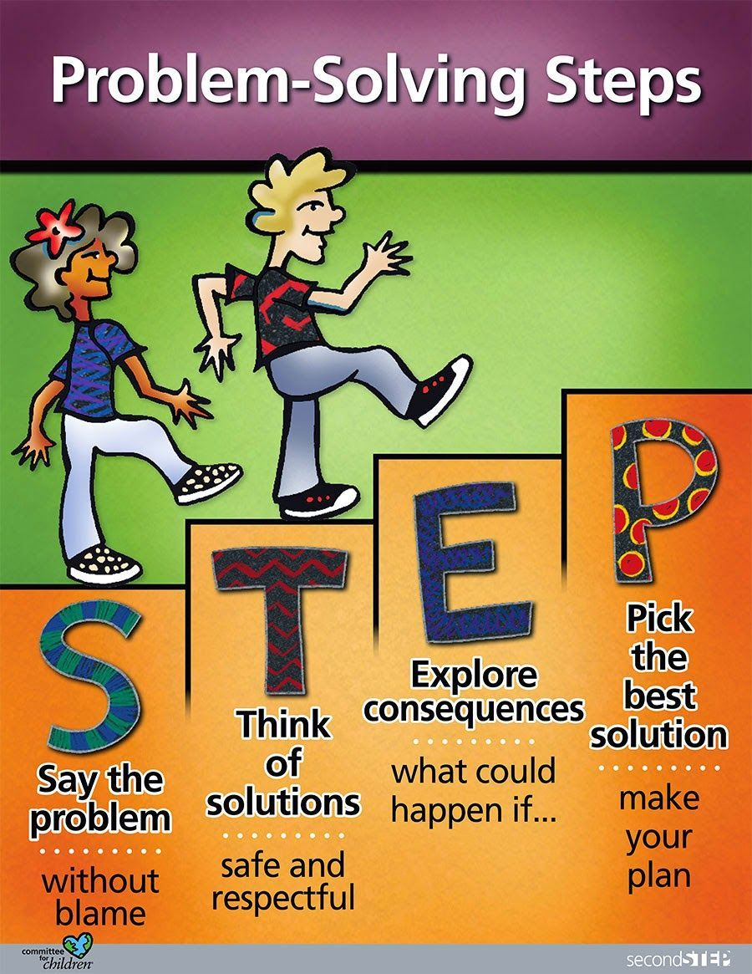
What is 2nd Step?
Second Step is a social emotional learning curriculum that focuses on four key areas of social emotional learning:
1. Skills for Learning: focus, listening, self-advocacy
2. Empathy: identify and understand feelings in self and others, how to take another’s perspective and show compassion.
3. Emotion Management: skills for calming down when experiencing big feelings
4. Problem Solving

Slide 6
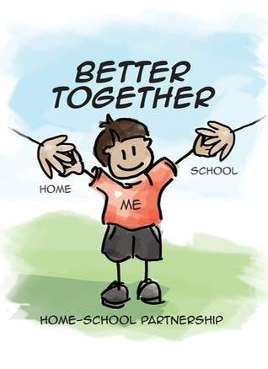
How can I help at home?
Teach/model/Reinforce skills for learning. SUPPORT.
Check in with your child. SUPPORT.
Ask for help when you need it.
-Teacher
-Coach or Counselor

